Slide 1


USENIX ATC 2023 Towards Iterative Relational Algebra on the GPU
Authors: Ahmedur Rahman Shovon, Thomas Gilray, Kristopher Micinski, Sidharth Kumar

Slide 2
Table of Contents
Datalog
Iterative Relational Algebra on GPU
Transitive Closure Computation​
Experimental Setup & Dataset
Results
Future Research Direction

Slide 3
Table of Contents
Datalog
Iterative Relational Algebra on GPU
Transitive Closure Computation​
Experimental Setup & Dataset
Results
Future Research Direction

Slide 4
Datalog: Bottom-Up Logic Programming Language
A lightweight logic-programming language for deductive-database systems
Running the Datalog program extends data from input database creating the output database with all data transitively derivable via the program rules
Input Database
Output Database
Datalog
(set of rules)
Ceri, S., Gottlob, G., & Tanca, L. (1989). What you always wanted to know about Datalog(and never dared to ask). IEEE transactions on knowledge and data engineering, 1(1), 146-166.
Gilray, T., Kumar, S., & Micinski, K. (2021, March). Compiling data-parallel datalog. In Proceedings of the 30th ACM SIGPLAN International Conference on Compiler Construction (pp. 23-35).

Slide 5
Classic Problems for Datalog
Transitive closure
Triangle counting
Finding maximal cliques
Finding frequent itemsets
Data mining
Oege De Moor, Georg Gottlob, Tim Furche, and Andrew Sellers. Datalog Reloaded: First InternationalWorkshop, Datalog 2010, Oxford, UK, March 16-19, 2010. Revised Selected Papers, volume 6702.Springer, 2012.
Jiwon Seo, Stephen Guo, and Monica S Lam. Socialite: Datalog extensions for efficient social networkanalysis. In 2013 IEEE 29th International Conference on Data Engineering (ICDE), pages 278–289.IEEE, 2013.

Slide 6
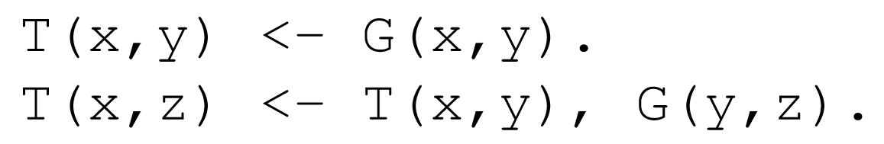
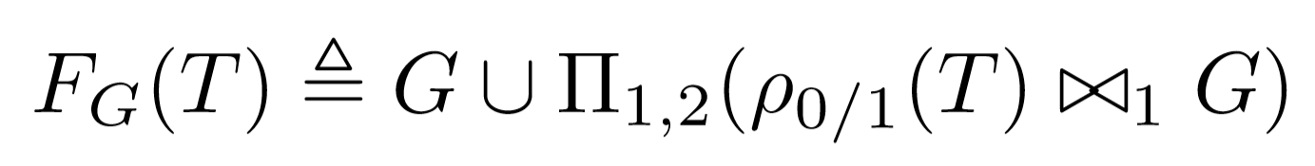
Bottom-Up Logic Programming with Datalog
Datalog rule for computing Transitive Closure (TC)
Datalog
Operationalized as a fixed-point iteration using F_{G}
Iterative
Relational Algebra
Relational algebra:
Union
Projection
Join
Gilray, T., & Kumar, S. (2019, December). Distributed relational algebra at scale. In 2019 IEEE 26th International Conference on High Performance Computing, Data, and Analytics (HiPC) (pp. 12-22). IEEE.
Kumar, S., & Gilray, T. (2020, June). Load-balancing parallel relational algebra. In International Conference on High Performance Computing (pp. 288-308). Springer, Cham.

Slide 7
Table of Contents
Datalog
Iterative Relational Algebra on GPU
Transitive Closure Computation​
Experimental Setup & Dataset
Results
Future Research Direction

Slide 8
Relational Algebra Primitives
Main relational algebra primitives of two flat relations R and S are:
Union: R ∪ S
Intersection: R ∩ S
Cartesian product: R × S
Join: R⨝S
Rename: ρ_{(i,j)}(R)
Selection: σ_{i}(R)
Projection: Π_{(i,j)}(R)
Differ from traditional set theory: R and S have a fixed arity
Relation
UserID | UserName | UserEmail
101 | Alice | alice@example.com
102 | Bob | bob@example.com
Tuple
(Row)
Attribute (Column)
Sidharth Kumar and Thomas Gilray. Distributed relational algebra at scale. In International Conference on High Performance Computing, Data, and Analytics (HiPC). IEEE, 2019.
Sidharth Kumar and Thomas Gilray. Load-balancing parallel relational algebra. In International Conference on High Performance Computing, pages 288–308. Springer, 2020.

Slide 9
Example of Natural Join ⨝
User
UserID | UserName | UserEmail
101 | Alice | alice@example.com
102 | Bob | bob@example.com
103 | Eve | eve@example.com
⨝
Order
UserID | OrderTotal | Items
101 | 25.69 | 2
102 | 145.66 | 3
103 | 12.11 | 1
103 | 44.00 | 2

Slide 10
Example of Natural Join ⨝
User
UserID | UserName | UserEmail
101 | Alice | alice@example.com
102 | Bob | bob@example.com
103 | Eve | eve@example.com
⨝
User
Order
⨝
UserID | UserName | UserEmail | OrderTotal | Items
101 | Alice | alice@example.com | 25.69 | 2
102 | Bob | bob@example.com | 145.66 | 3
103 | Eve | eve@example.com | 12.11 | 1
101 | Alice | alice@example.com | 44.00 | 2
Order
UserID | OrderTotal | Items
101 | 25.69 | 2
102 | 145.66 | 3
103 | 12.11 | 1
103 | 44.00 | 2

Slide 11
Example of Natural Join ⨝
User
UserID | UserName | UserEmail
101 | Alice | alice@example.com
102 | Bob | bob@example.com
103 | Eve | eve@example.com
⨝
User
Order
⨝
UserID | UserName | UserEmail | OrderTotal | Items
101 | Alice | alice@example.com | 25.69 | 2
102 | Bob | bob@example.com | 145.66 | 3
103 | Eve | eve@example.com | 12.11 | 1
101 | Alice | alice@example.com | 44.00 | 2
Order
UserID | OrderTotal | Items
101 | 25.69 | 2
102 | 145.66 | 3
103 | 12.11 | 1
103 | 44.00 | 2

Slide 12
Example of Natural Join ⨝
User
UserID | UserName | UserEmail
101 | Alice | alice@example.com
102 | Bob | bob@example.com
103 | Eve | eve@example.com
⨝
User
Order
⨝
UserID | UserName | UserEmail | OrderTotal | Items
101 | Alice | alice@example.com | 25.69 | 2
102 | Bob | bob@example.com | 145.66 | 3
103 | Eve | eve@example.com | 12.11 | 1
101 | Alice | alice@example.com | 44.00 | 2
Order
UserID | OrderTotal | Items
101 | 25.69 | 2
102 | 145.66 | 3
103 | 12.11 | 1
103 | 44.00 | 2

Slide 13
Example of Natural Join ⨝
User
UserID | UserName | UserEmail
101 | Alice | alice@example.com
102 | Bob | bob@example.com
103 | Eve | eve@example.com
⨝
User
Order
⨝
UserID | UserName | UserEmail | OrderTotal | Items
101 | Alice | alice@example.com | 25.69 | 2
102 | Bob | bob@example.com | 145.66 | 3
103 | Eve | eve@example.com | 12.11 | 1
103 | Eve | eve@example.com | 44.00 | 2
Order
UserID | OrderTotal | Items
101 | 25.69 | 2
102 | 145.66 | 3
103 | 12.11 | 1
103 | 44.00 | 2

Slide 14
Duplicates on Join Result
User ⨝ Order
UserID | UserName | UserEmail | OrderTotal | Items
101 | Alice | alice@example.com | 25.69 | 2
102 | Bob | bob@example.com | 145.66 | 3
103 | Eve | eve@example.com | 12.11 | 1
103 | Eve | eve@example.com | 44.00 | 2
Π(_{UserName,UserEmail})(User ⨝ Order)
UserName | UserEmail
Alice | alice@example.com
Bob | bob@example.com
Eve | eve@example.com
Eve | eve@example.com

Slide 15
Towards Parallel Relational Algebra
Datalog
Iterative Relational Algebra
Thread Parallel (Soufflé)
Node Parallel (DPRA)
GPU Parallel (This work)
Herbert Jordan, Bernhard Scholz, and Pavle Suboti´c. Souffl´e: On synthesis of program analyzers. InInternational Conference on Computer Aided Verification, pages 422–430. Springer, 2016.
Kumar, S., & Gilray, T. (2019). Distributed relational algebra at scale. In International Conference on High Performance Computing, Data, and Analytics (HiPC). IEEE (Vol. 1).
Thomas Gilray, Sidharth Kumar, and Kristopher Micinski. Compiling data-parallel datalog. In Proceedings of the 30th ACM SIGPLAN International Conference on Compiler Construction, CC 2021,page 23–35, New York, NY, USA, 2021. Association for Computing Machinery.

Slide 16
Parallel Join: Algorithms
Popular algorithms
Sort-Merge Join (SMJ)
Hash Join (HJ)
SMJ is suitable for small to medium-sized tables, HJ is suitable for large tables
Chengxin Guo, Hong Chen, Feng Zhang, and Cuiping Li. Parallel hybrid join algorithm on gpu. 2019IEEE 21st International Conference on High Performance Computing and Communications; IEEE17th International Conference on Smart City; IEEE 5th International Conference on Data Science andSystems (HPCC/SmartCity/DSS), pages 1572–1579, 2019.
Hongzhi Wang, Ning Li, Zheng ke Wang, and Jianing Li. Gpu-based efficient join algorithms on hadoop.The Journal of Supercomputing, 77:292 – 321, 2020.

Slide 17
Research Gaps in Parallel Join Implementations
GPU-based join implementations does not sort result (by default)
Challenge for iterated relational algebra algorithms
Negative impact on algorithm performance
Memory overhead in Python libraries

Slide 18
Table of Contents
Datalog
Iterative Relational Algebra on GPU
Transitive Closure Computation​
Experimental Setup & Dataset
Results
Future Research Direction

Slide 19
Transitive Closure: Logical Inference for Graphs
1
G
1
T
T(x,y) <- G(x,y)
T(x,z) <- T(x,y),G(y,z)
0
3
4
0
3
4
2
2
0​ | 1​
0 | 2​
1​ | 3​
2​ | 3​
3 | 4
0​ | 1​
0​ | 2​
1​ | 3​
2​ | 3​
3​ | 4​
0​ | 3​
1​ | 4​
2​ | 4​
0​ | 4​

Slide 20
Transitive Closure: Iterations
1
T
0
3
4
2
0​ | 1​
0​ | 2​
1​ | 3​
2​ | 3​
3​ | 4​

Slide 21
Transitive Closure: Iterations 1
1
1
T
0
3
4
0
3
4
2
2
0​ | 1​
0​ | 2​
1​ | 3​
2​ | 3​
3​ | 4​
0​ | 1​
0​ | 2​
1​ | 3​
2​ | 3​
3​ | 4​
0​ | 3​
1​ | 4​
2​ | 4​

Slide 22
Transitive Closure: Iterations 2
1
1
1
T
0
3
4
0
3
4
0
3
4
2
2
2
0​ | 1​
0​ | 2​
1​ | 3​
2​ | 3​
3​ | 4​
0​ | 1​
0​ | 2​
1​ | 3​
2​ | 3​
3​ | 4​
0​ | 3​
1​ | 4​
2​ | 4​
0​ | 1​
0​ | 2​
1​ | 3​
2​ | 3​
3​ | 4​
0​ | 3​
1​ | 4​
2​ | 4​
0​ | 4​

Slide 23
Transitive Closure: Iterations 3
1
1
1
1
T
0
3
4
0
3
4
0
3
4
0
3
4
2
2
2
2
0​ | 1​
0​ | 2​
1​ | 3​
2​ | 3​
3​ | 4​
0​ | 1​
0​ | 2​
1​ | 3​
2​ | 3​
3​ | 4​
0​ | 3​
1​ | 4​
2​ | 4​
0​ | 1​
0​ | 2​
1​ | 3​
2​ | 3​
3​ | 4​
0​ | 3​
1​ | 4​
2​ | 4​
0​ | 4​
0​ | 1​
0​ | 2​
1​ | 3​
2​ | 3​
3​ | 4​
0​ | 3​
1​ | 4​
2​ | 4​
0​ | 4​

Slide 24
TC Computation in Iterated Relational Algebra
Hash Table

Slide 25
TC Computation in Iterated Relational Algebra
Hash Table
Hash Join

Slide 26
TC Computation in Iterated Relational Algebra
Hash Table
Hash Join
Sorting,
deduplication

Slide 27
TC Computation in Iterated Relational Algebra
Hash Table
Hash Join
Sorting,
deduplication
TC

Slide 28
Hash Table (Open Addressing, Linear Probing)
Grid Stride Loop
0
1
...
511
. . .
Block 0
35
44
11
23
. . .
. . .
0
1
...
511
46
31
. . .
Block n
97
32
CUDA Threads
Key - Value
Hash Table
Key-Value Pair

Slide 29
Hash Table (Open Addressing, Linear Probing)
Grid Stride Loop
Murmur 3 hashing
0
1
...
511
35
44
. . .
Block 0
35
44
11
23
11
23
. . .
. . .
0
1
...
511
AtomicCAS
46
31
. . .
Block n
97
32
CUDA Threads
Key - Value
Hash Table
Key-Value Pair

Slide 30
Hash Table (Open Addressing, Linear Probing)
Grid Stride Loop
Murmur 3 hashing
0
1
...
511
35
44
. . .
Block 0
35
44
11
23
11
23
. . .
. . .
0
1
...
511
AtomicCAS
46
31
. . .
Block n
97
32
CUDA Threads
Key - Value
Hash Table
Key-Value Pair

Slide 31
Hash Table (Open Addressing, Linear Probing)
Grid Stride Loop
Murmur 3 hashing
0
1
...
511
35
44
. . .
Block 0
35
44
11
23
11
23
. . .
. . .
0
1
...
511
AtomicCAS
46
31
. . .
Block n
97
32
CUDA Threads
Key - Value
Hash Table
Key-Value Pair

Slide 32
Hash Table (Open Addressing, Linear Probing)
Grid Stride Loop
Murmur 3 hashing
0
1
...
511
35
44
. . .
Block 0
35
44
11
23
11
23
. . .
. . .
0
1
...
511
AtomicCAS
46
31
. . .
Block n
97
32
Collision -> Linear probing (Position + 1) & hash table size
CUDA Threads
Key - Value
Hash Table
Key-Value Pair

Slide 33
Hash Table (Open Addressing, Linear Probing)
Grid Stride Loop
Murmur 3 hashing
0
1
...
511
35
44
. . .
Block 0
35
44
11
23
11
23
. . .
. . .
0
1
...
511
AtomicCAS
46
31
. . .
Block n
46
31
97
32
Collision -> Linear probing (Position + 1) & hash table size
97
32
CUDA Threads
Key - Value
Hash Table
Key-Value Pair

Slide 34
Performing Hash Join on GPU
Static Hash Table
Reverse Relation
Key | Value
Key | Value
Calculate join size
⨝
First pass

Slide 35
Performing Hash Join on GPU
Static Hash Table
Reverse Relation
Key | Value
Key | Value
Calculate join size
⨝
First pass
Prefix sum
Join Result
Second pass
(fused projection)
Join Key | Value 1 | Value 2

Slide 36
Performing Hash Join on GPU
Static Hash Table
Reverse Relation
Key | Value
Key | Value
Calculate join size
⨝
First pass
Prefix sum
Join Result
Second pass
(fused projection)
Join Key | Value 1 | Value 2
Sort and Unique
Deduplicated Join Result
Key | Value

Slide 37
Transitive closure computation (single iteration)
Static Hash Table
Reverse Relation
T_{new}
T_{full} = T ∪ T_{new}
T
Key | Value
Key | Value
Key | Value
Key | Value
Key | Value
⨝
Merge
and
Unique
Process continues until there is no new facts are discovered in an iteration

Slide 38
Table of Contents
Datalog
Iterative Relational Algebra on GPU
Transitive Closure Computation​
Experimental Setup & Dataset
Results
Future Research Direction

Slide 39
Experiment Platform and Datasets
ThetaGPU supercomputer from Argonne National Lab
CPU: AMD EPYC 7742 processors with 3.31GHz clock speed, 128 cores
GPU
NVIDIA A100 Tensor Core GPU with 40GB GPU memory
108 multiprocessors on device (SM)
Environment
CUDA version 11.4, 3,456 x 512 (blocks per grid x threads per block)
Souffle version 2.3 with 128 threads
Datasets
Stanford large network dataset collection
SuiteSparse matrix collection
Road network real datasets collection
cuDF package inside conda environment
Leskovec, J., & Krevl, A. (2014). SNAP Datasets: Stanford large network dataset collection.

Slide 40
Table of Contents
Datalog
Iterative Relational Algebra on GPU
Transitive Closure Computation​
Experimental Setup & Dataset
Results
Future Research Direction

Slide 41
Hash Table Performance
Build rate:
Random synthetic graph: 400 million keys/second
String graph: 4 billion keys/second
Load factors are varied to ensure less memory overhead

Slide 42
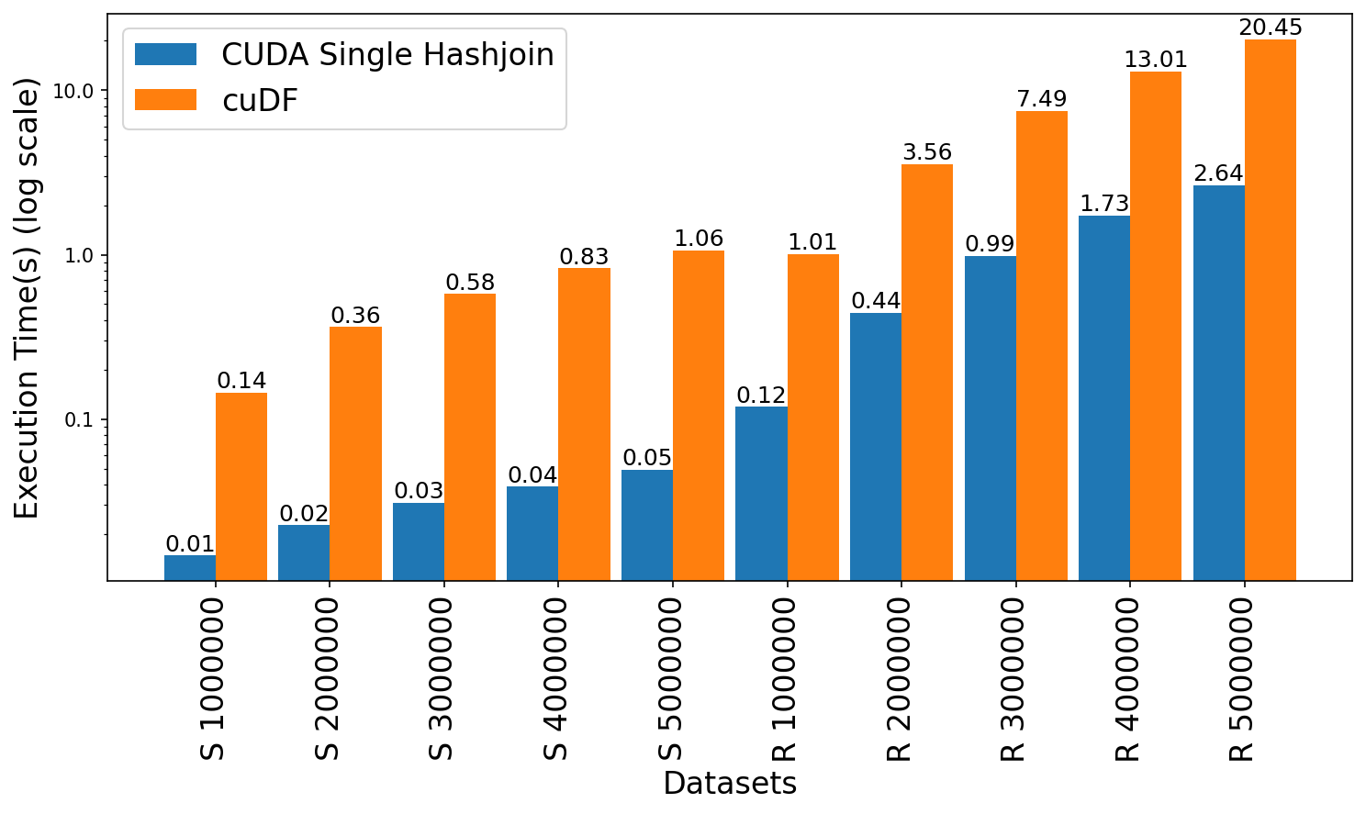
Join Performance Comparison: CUDA vs cuDF
Leadership Computing Facility, A. (2022). Argonne Leadership Computing Facility. Theta GPU Nodes. URL: https://www.alcf.anl.gov/support-center/theta-gpu-nodes
Notes:
Observe up to 21x speedup for string graph
Observe 7.6x to 8.4x speedup for random graph

Slide 43
CUDA Advantages over Dataframe
Fuse operations
Thread-block configuration
Memory management
Optimize data structure
Jason. Sanders. CUDA by example : an introduction to general-purpose GPU programming. AddisonWesley, Upper Saddle River, NJ, 2011.
John Cheng, Max Grossman, and Ty McKercher. Professional CUDA c programming. John Wiley & Sons, 2014

Slide 44
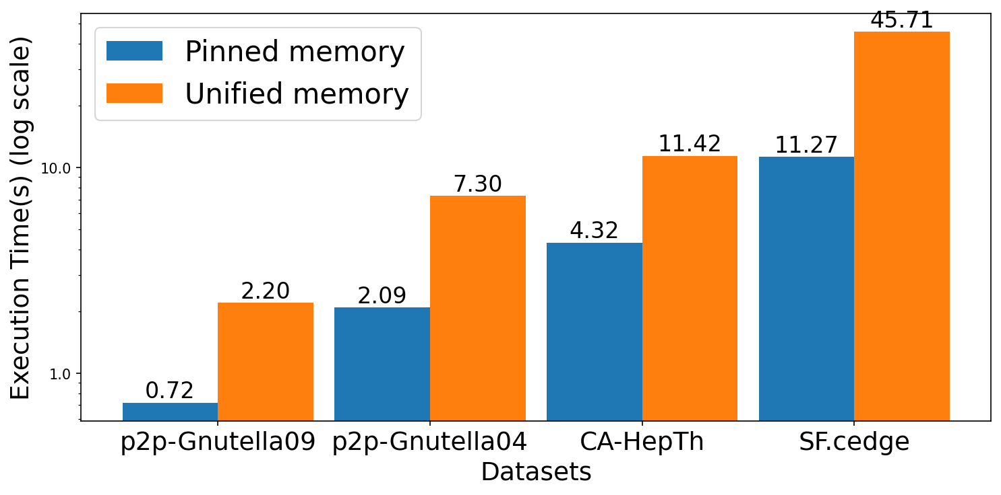
TC Performance Comparison: Memory Schemes
Leadership Computing Facility, A. (2022). Argonne Leadership Computing Facility. Theta GPU Nodes. URL: https://www.alcf.anl.gov/support-center/theta-gpu-nodes
Notes:
Observes 2.6x to 4.1x speedup for transitive closure computation using the pinned memory over the unified memory model

Slide 45
TC Performance Comparison: CUDA vs Soufflé vs cuDF
Dataset | Type | Rows | TC size | Iterations | CUDA Hashjoin(s) | Soufflé(s) | cuDF(s)
fe_ocean | U | 409,593 | 1,669,750,513 | 247 | 138.237 | 536.233 | Out of Memory
p2p-Gnutella31 | D | 147,892 | 884,179,859 | 31 | Out of Memory | 128.917 | Out of memory
usroads | U | 165,435 | 871,365,688 | 606 | 364.554 | 222.761 | Out of Memory
fe_body | U | 163,734 | 156,120,489 | 188 | 47.758 | 29.07 | Out of Memory
loc-Brightkite | U | 214,078 | 138,269,412 | 24 | 15.88 | 29.184 | Out of Memory
SF.cedge | U | 223,001 | 80,498,014 | 287 | 11.274 | 17.073 | 64.417
fe_sphere | U | 49,152 | 78,557,912 | 188 | 13.159 | 20.008 | 80.077
CA-HepTh | D | 51,971 | 74,619,885 | 18 | 4.318 | 15.206 | 26.115
p2p-Gnutella04 | D | 39,994 | 47,059,527 | 26 | 2.092 | 7.537 | 14.005
p2p-Gnutella09 | D | 26,013 | 21,402,960 | 20 | 0.72 | 3.094 | 3.906
wiki-Vote | D | 103,689 | 11,947,132 | 10 | 1.137 | 3.172 | 6.841
cti | U | 48,232 | 6,859,653 | 53 | 0.295 | 1.496 | 3.181
delaunay_n16 | U | 196,575 | 6,137,959 | 101 | 1.137 | 1.612 | 5.596
luxembourg_osm | U | 119,666 | 5,022,084 | 426 | 1.322 | 2.548 | 8.194
ego-Facebook | U | 88,234 | 2,508,102 | 17 | 0.544 | 0.606 | 3.719
cal.cedge | U | 21,693 | 501,755 | 195 | 0.489 | 0.455 | 2.756
TG.cedge | U | 23,874 | 481,121 | 58 | 0.198 | 0.219 | 0.857
wing | U | 121,544 | 329,438 | 11 | 0.085 | 0.193 | 0.905
OL.cedge | U | 7,035 | 146,120 | 64 | 0.148 | 0.181 | 0.523
Notes:
Observe up to 3.9x over Souffle
Observe up to 10.8x speedup over cuDF

Slide 46

Cases Where Souffle Outperforms CUDA
Overflows GPU memory when higher workload/iteration
Underperforms when less work for GPU/iteration

Slide 47
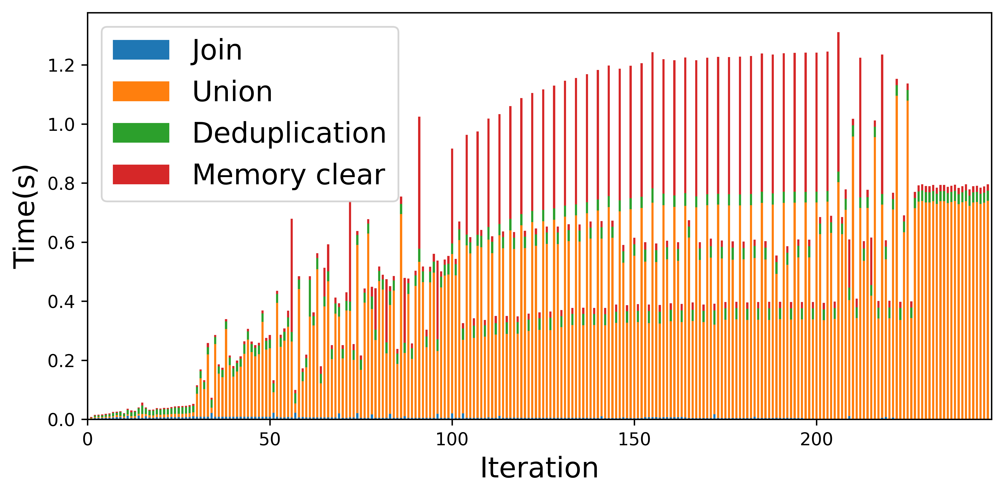
Operations Breakdown per Iteration (fe_ocean)
Leadership Computing Facility, A. (2022). Argonne Leadership Computing Facility. Theta GPU Nodes. URL: https://www.alcf.anl.gov/support-center/theta-gpu-nodes

Slide 48
Contributions
High Performance GPU hash table for iterative RA
Operations optimization (fuse join and projection)
Overcome deduplication challenge
Efficient GPU memory management (pinned and buffer clearance)

Slide 49

Limitations
Limited to a single GPU that dictates scaling by available VRAM on the GPU
Memory overflow error for larger graphs
Open addressing based hash table causes memory overhead

Slide 50
Table of Contents
Datalog
Iterative Relational Algebra on GPU
Transitive Closure Computation​
Experimental Setup & Dataset
Results
Future Research Direction

Slide 51
Future Work
Different Parallel Programming Models performance on iterative relational join
Multi-node multi-GPU backend for Datalog to perform iterated relational algebra operations tailored for GPU
Extend
Develop
Compare
State-of-the-art multi-node CPU-based Datalog-like language SLOG to leverage our GPU-based solutions

Slide 52




https://github.com/harp-lab/usenixatc23

Slide 53

Thank you!
HARP Lab
High-performance Automated Reasoning and Programming Lab
https://github.com/harp-lab/

Slide 54
Appendix

Slide 55
DataFrame Based Datalog Applications
Advantages
Limitations
Abstract memory management
Abstract thread block configuration
Same API signatures for CPU and GPU
Easy-to-code interface
No fusing
Memory and computation overhead
No consecutive operation
Memory limitation
A. R. Shovon, L. R. Dyken, O. Green, T. Gilray and S. Kumar, "Accelerating Datalog applications with cuDF," 2022 IEEE/ACM Workshop on Irregular Applications: Architectures and Algorithms (IA3), Dallas, TX, USA, 2022, pp. 41-45
Green, O., Du, Z., Patel, S., Xie, Z., Liu, H., & Bader, D. A. (2021, December). Anti-Section Transitive Closure. In 2021 IEEE 28th International Conference on High Performance Computing, Data, and Analytics (HiPC) (pp. 192-201). IEEE.
Team, R. D. (2018). RAPIDS: Collection of libraries for end to end GPU data science. NVIDIA, Santa Clara, CA, USA. https://rapids.ai

Slide 56

Datalog Example
Facts:
parents(x,y).
children(y,x).
Rules:
grandparent(x,y) :- parents(x,z), parents(z,y).
extensional
intensional
head
body
Michael Stonebraker. Readings in database systems. Morgan Kaufmann Publishers Inc., 1988
Evgeny Dantsin, Thomas Eiter, Georg Gottlob, and Andrei Voronkov. Complexity and expressivepower of logic programming. ACM Comput. Surv., 33(3):374–425, sep 2001.
David Maier, K Tuncay Tekle, Michael Kifer, and David S Warren. Datalog: concepts, history, andoutlook. In Declarative Logic Programming: Theory, Systems, and Applications, pages 3–100. 2018.

Slide 57
Parallel Join
What: Perform relational join operation simultaneously on a number of processors or machines
When: Useful when input data is enormous and the join is computationally costly
How: Divide the data into partitions and assign each partition to a different processor
Daniel Zinn, Haicheng Wu, Jin Wang, Molham Aref, and Sudhakar Yalamanchili. General-purpose join algorithms for large graph triangle listing on heterogeneous systems. In Proceedings of the 9th Annual Workshop on General Purpose Processing Using Graphics Processing Unit, pages 12–21, 2016.

Slide 58
Datalog Timeline
1970
Horn Clauses, McCarthy
1972
Prolog, Kowalski
1975
Datalog, Maier
1977
1978
Workshop, Gallaire, Minker
LDL, Commercial
Popular, Databases
1980s
Decline, New Technologies
1990s
Regains Popularity, Semantic Web
2000s
Deductive Database, Data Mining, ML
2010s
Stefano Ceri, Georg Gottlob, Letizia Tanca, et al. What you always wanted to know about datalog(andnever dared to ask). IEEE transactions on knowledge and data engineering, 1(1):146–166, 1989
David Maier, K Tuncay Tekle, Michael Kifer, and David S Warren. Datalog: concepts, history, andoutlook. In Declarative Logic Programming: Theory, Systems, and Applications, pages 3–100. 2018.
Shan Shan Huang, Todd Jeffrey Green, and Boon Thau Loo. Datalog and emerging applications:An interactive tutorial. In Proceedings of the 2011 ACM SIGMOD International Conference onManagement of Data, SIGMOD ’11, page 1213–1216, New York, NY, USA, 2011. Association forComputing Machinery.
Notes:
Here is a timeline of the development of Datalog:
1970: John McCarthy publishes the paper "A Formal Description of Data Languages". This paper introduces the concept of Horn clauses, which are the basis of Datalog.
1972: Robert Kowalski publishes the paper "Logic for Problem Solving". This paper introduces the logic programming language Prolog, which is based on Horn clauses.
1975: David Maier coins the term "Datalog".
1977: Hervé Gallaire and Jack Minker organize a workshop on logic and databases. This workshop helps to raise awareness of Datalog and its potential for database applications.
1978: The first commercial Datalog system, called LDL, is released.
1980s: Datalog becomes increasingly popular for database applications.
1990s: The development of new database technologies, such as object-oriented databases and relational databases with triggers, leads to a decline in the popularity of Datalog.
2000s: Datalog regains some popularity due to its simplicity and efficiency. It is also used in new application areas, such as the Semantic Web.
2010s: Datalog continues to be used in a variety of applications, including database querying, data mining, and machine learning.

Slide 59
Datalog Applications
Modern Datalog implementations: Soufflé, SLOG, LogicBlox, RadLog, PRAM
Domains
Deductive database
Machine learning
Software analysis
Business analytics
Martin Bravenboer and Yannis Smaragdakis. Strictly declarative specification of sophisticated points-toanalyses. In Proceedings of the 24th ACM SIGPLAN conference on Object oriented programming systems languages and applications, pages 243–262, 2009.
Jiwon Seo, Stephen Guo, and Monica S Lam. Socialite: Datalog extensions for efficient social networkanalysis. In 2013 IEEE 29th International Conference on Data Engineering (ICDE), pages 278–289.IEEE, 2013

Slide 60
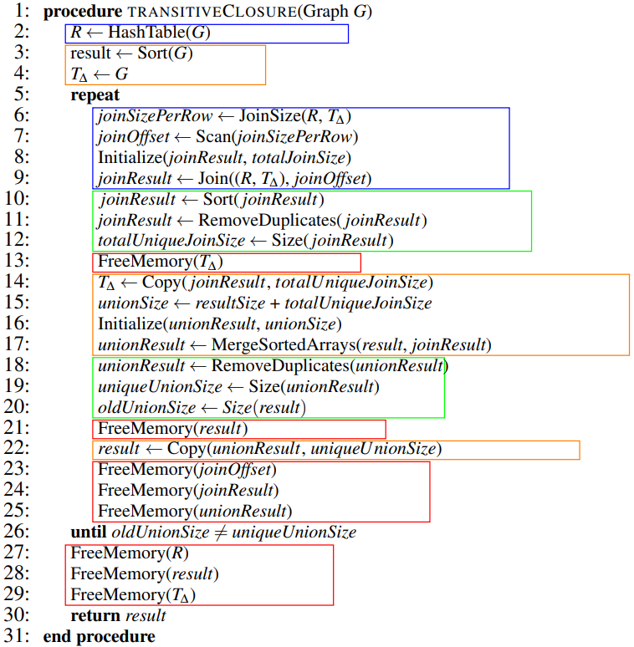
Algorithm for TC computation using CUDA
Open-Addressing based hash table
Two pass approach to perform hash join on the GPU
Deduplication using sort and unique, merge and unique

Slide 61


Off-the-shelf Data Structure
DataFrame: 2D labeled tabular data structure
GPU (NVIDIA)
CPU
Both supports RA primitives (e.g. join, aggregation, rename, deduplication, and projection)
Reback, J., McKinney, W., Van Den Bossche, J., Augspurger, T., Cloud, P., Klein, A., ... & Seabold, S. (2020). pandas-dev/pandas: Pandas 1.0. 5. Zenodo.
Chen, D. Y. (2017). Pandas for everyone: Python data analysis. Addison-Wesley Professional.
Green, O., Du, Z., Patel, S., Xie, Z., Liu, H., & Bader, D. A. (2021, December). Anti-Section Transitive Closure. In 2021 IEEE 28th International Conference on High Performance Computing, Data, and Analytics (HiPC) (pp. 192-201). IEEE.
Fender, A., Rees, B., & Eaton, J. RAPIDS cuGraph. In Massive Graph Analytics (pp. 483-493). Chapman and Hall/CRC.

Slide 62
Hash Join Initialization on GPU
Input Relation
Static Hash Table
Key | Value
Key | Value
Reverse Relation
Key | Value

Slide 63
Why Join is Important in RA?
Combine data from multiple tables
Find patterns in data
Clean data
Create new data sets
Daniel Zinn, Haicheng Wu, Jin Wang, Molham Aref, and Sudhakar Yalamanchili. General-purpose join algorithms for large graph triangle listing on heterogeneous systems. In Proceedings of the 9th Annual Workshop on General Purpose Processing Using Graphics Processing Unit, pages 12–21, 2016.

Slide 64
Soufflé
A variant of Datalog for static analysis using OpenMP
State-of-the-art implementation for multi-core CPU systems with single-node
Translates Datalog programs to optimized C++ programs
Supports limited number of threads for task-level parallelism
Cannot provide data parallelism
Herbert Jordan, Bernhard Scholz, and Pavle Suboti´c. Souffl´e: On synthesis of program analyzers. InInternational Conference on Computer Aided Verification, pages 422–430. Springer, 2016.
Thomas Gilray, Sidharth Kumar, and Kristopher Micinski. Compiling data-parallel datalog. InProceedings of the 30th ACM SIGPLAN International Conference on Compiler Construction, CC 2021,page 23–35, New York, NY, USA, 2021. Association for Computing Machinery.

Slide 65
Parallel Join (Continue)
Design
Consider partition, load balancing, communication
Challenging due to the uncertain output size
Efficient joins requires sorting or indexing
Optimize
Implement
Daniel Zinn, Haicheng Wu, Jin Wang, Molham Aref, and Sudhakar Yalamanchili. General-purpose join algorithms for large graph triangle listing on heterogeneous systems. In Proceedings of the 9th Annual Workshop on General Purpose Processing Using Graphics Processing Unit, pages 12–21, 2016.

Slide 66
Hybrid Join Algorithm
Guo et al. proposed PHYJ: SMJ with HJ join
Reduced host-to-device and device-to-host
Fused data communication with GPU execution
On a single GPU achieved up to 1.72X speedup
Can handle skewed data
No information on multiple GPUs or distributed systems
Chengxin Guo, Hong Chen, Feng Zhang, and Cuiping Li. Parallel hybrid join algorithm on gpu. 2019IEEE 21st International Conference on High Performance Computing and Communications; IEEE17th International Conference on Smart City; IEEE 5th International Conference on Data Science andSystems (HPCC/SmartCity/DSS), pages 1572–1579, 2019.
Hongzhi Wang, Ning Li, Zheng ke Wang, and Jianing Li. Gpu-based efficient join algorithms on hadoop.The Journal of Supercomputing, 77:292 – 321, 2020.
Notes:
Introduced a pipeline technique to reduce host-to-device and device-to-host bidirectional communication costs by fusing data communication with GPU execution on setting the input and output relation

Slide 67
Join on GPUs: Benchmark
Rui et al. assessed NINLJ, INLJ, SMJ, and HJ on modern GPU
Modern GPUs can lead to 20X speedup VS 7X speedup of old GPUs
Not suitable for HPC systems with multiple GPU environments
New GPU architecture is introduced (Nvidia Hopper architecture)
Bingsheng He, Ke Yang, Rui Fang, Mian Lu, Naga Govindaraju, Qiong Luo, and Pedro Sander.Relational joins on graphics processors. In Proceedings of the 2008 ACM SIGMOD internationalconference on Management of data, pages 511–524, 2008.
Ran Rui, Hao Li, and Yi-Cheng Tu. Join algorithms on gpus: A revisit after seven years. In 2015 IEEEInternational Conference on Big Data (Big Data), pages 2541–2550. IEEE, 2015.
Anne C Elster and Tor A Haugdahl. Nvidia hopper gpu and grace cpu highlights. Computing in Science& Engineering, 24(2):95–100, 2022.

Slide 68
Join on GPUs: LogiQL
Wu et al. presents Red Fox high-performance accelerator core for LogiQL queries
Outperforms multi-threaded CPU-based implementations
Novel: multi-predicate join algorithm (worst-case optimal) on GPU
Issue: deduplication of tuples and maintaining join result in sorted order
Haicheng Wu, Gregory Diamos, Tim Sheard, Molham Aref, Sean Baxter, Michael Garland, andSudhakar Yalamanchili. Red fox: An execution environment for relational query processing on gpus. InProceedings of Annual IEEE/ACM International Symposium on Code Generation and Optimization,pages 44–54, 2014.
Haicheng Wu. Acceleration and execution of relational queries using general purpose graphics processingunit (GPGPU). PhD thesis, Georgia Institute of Technology, 2015.

Slide 69
Join on GPUs: Relational Learning Framework
Expedites rule coverage on GPUs for healthcare records data
Outperforms 75% of applications over multi-core CPU systems
Duplicate tuples not efficiently managed and GPU memory overflows
Carlos Alberto Mart´ınez-Angeles, Haicheng Wu, Inˆes Dutra, V´ıtor Santos Costa, and Jorge BuenabadCh´avez. Relational learning with gpus: Accelerating rule coverage. International Journal of ParallelProgramming, 44(3):663–685, 2016

Slide 70
Join on GPUs: Control Flow Analysis (CFA)
Parallel functional CFA encoded in Datalog utilizes RA as the foundation on GPU
Extended Red Fox combining GPU parallelism with multi-node multi-core HPC
Proposed partitioned global address space (PGAS) programming model
THOMAS GILRAY and SIDHARTH KUMAR. Toward parallel cfa with datalog, mpi, and cuda. InScheme and Functional Programming Workshop, 2017.

Slide 71
Join on GPUs: WarpDrive
Jünger et al. presented a single-node multi-GPU hashing for hashjoin
Attained better memory coalescing
Hashtable insertion rate:
1.4B keys/sec (single GPU)
4.3B keys/sec (4 GPUs)
32 bit keys only with no deduplication
Incremental study: WarpCore supports 64 bit keys
Daniel J¨unger, Christian Hundt, and Bertil Schmidt. Warpdrive: Massively parallel hashing on multigpu nodes. In 2018 IEEE International Parallel and Distributed Processing Symposium (IPDPS), pages441–450. IEEE, 2018.
Daniel J¨unger, Robin Kobus, Andr´e M¨uller, Christian Hundt, Kai Xu, Weiguo Liu, and Bertil Schmidt.Warpcore: A library for fast hash tables on gpus. In 2020 IEEE 27th International Conference on HighPerformance Computing, Data, and Analytics (HiPC), pages 11–20, 2020.

